Slide 1

Environmental Pollution due to the LAKWIJAYA POWER PLANT
GROUP C2

Slide 2

GROUP MEMBERS
2018/E/107
2018/E/108
2018/E/109
2018/E/110
2018/E/111
2018/E/112
SUBTITLE GOES HERE
Notes:
© Copyright Showeet.com – Free PowerPoint Templates

Slide 3

Knowledge and understanding of the topic
Norochcholai power plant or else Lakwijaya power plant is the very first coal fired power plant set up in Sri Lanka.
The power station in Norochcholai, Puttalam on the Southern end of the Kalpitiya Peninsula.
Construction of the facility began on 11 May 2006.
The first unit commissioning on 22 March 2011 with 300 MWs.
The name plate capacity is 900 MW and completed 2014 with total power generation
Notes:
© Copyright Showeet.com – Free PowerPoint Templates

Slide 4
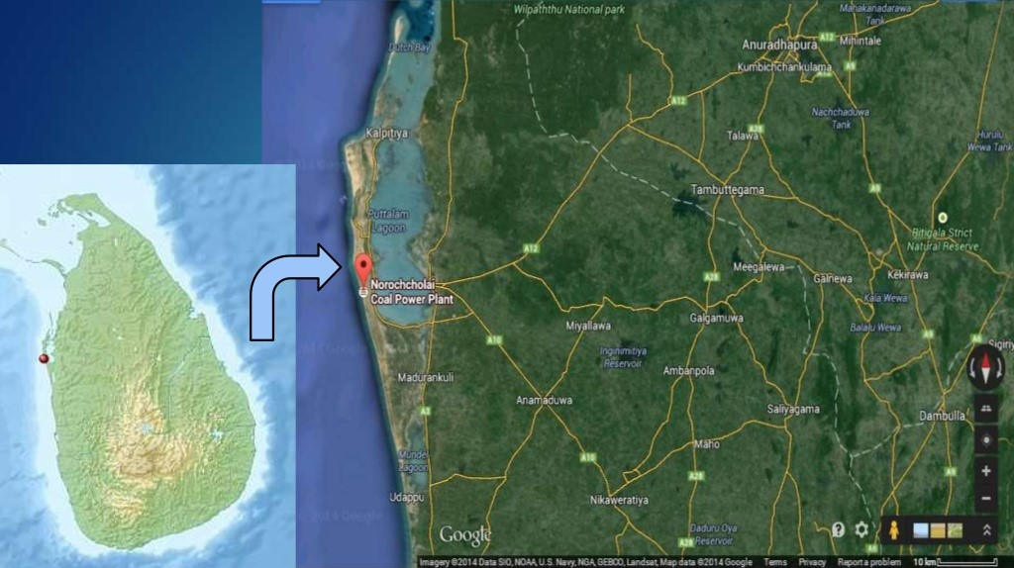
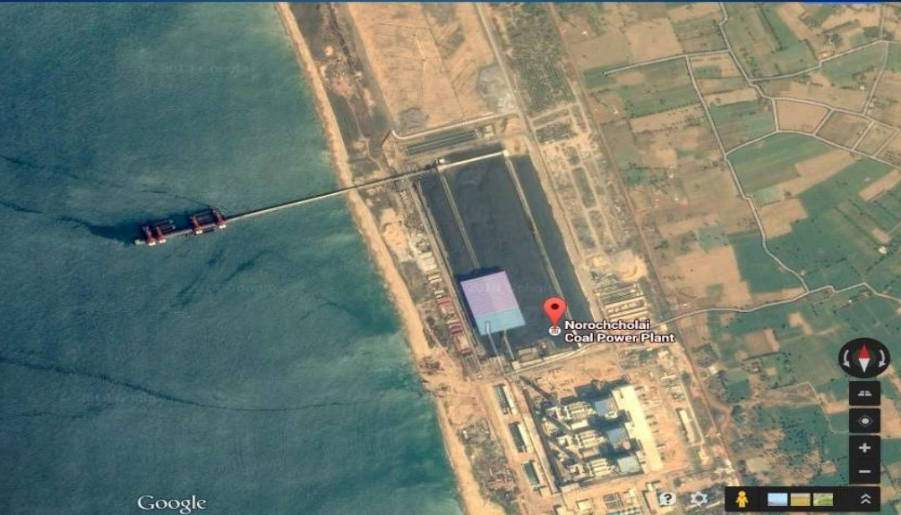
Location

Slide 5
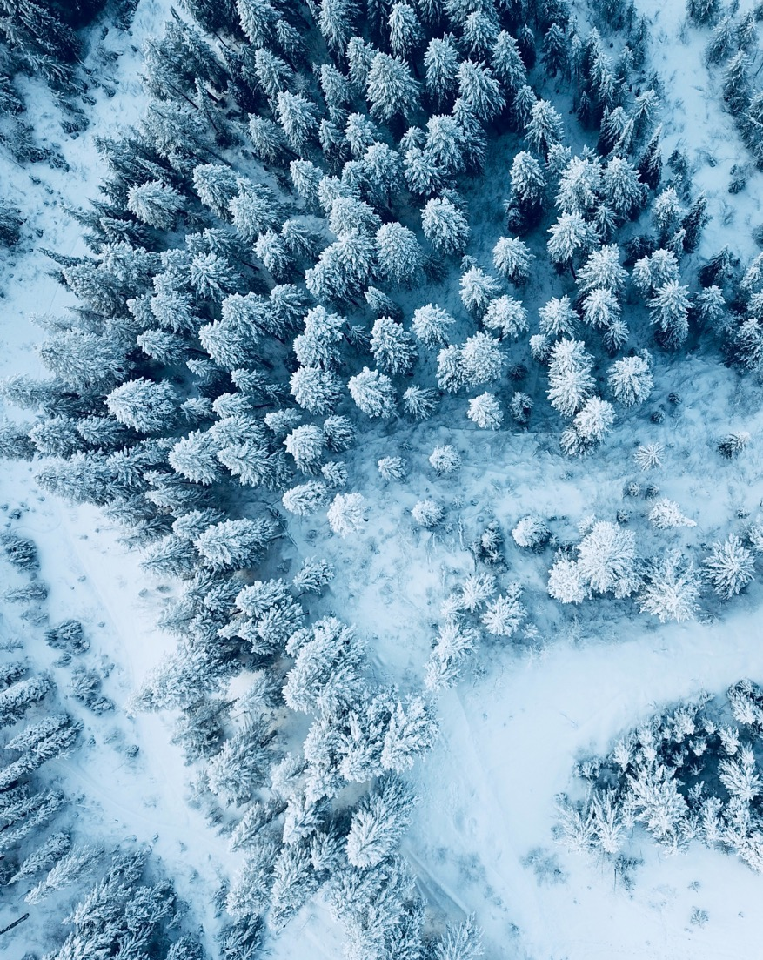
understanding of the topic
As a result of coal power generation,
The national cancer control programmer (NCCP) said that coal plant impact to the health, safety and livelihoods of surroundings communities and
cause some damage to the environment ; both land and sea.
releases greenhouse gases and toxins
The burning of the coal releases greenhouse gases and toxins. Such as CO2, SO2, SO3,NO2 and etc.
coal combustion produces ashes.
The coal combustion produces some residue; such as fly ash, bottom ash (deposited in the system) and boiler slag. These materials are affect to both human health and environmental sustenance as they contain heavy metals such as mercury and radioactive nucleoids
Notes:
© Copyright Showeet.com – Free PowerPoint Templates

Slide 6
The used heat water release to the sea
For the working of turbines the water is heated and made steam. After steam going through turbines waste water is released to a cannel and going to the sea. That water have some heat and it is not good for the both sea plants and sea animals .
The water which used for bubbling burning gases have included heavy metals and chemicals.
The burning gas filtering water include some heavy metals. Such as hg, pb and etc. As well as Sulfuric acid, Nitric acid, Sulfurous acid, Carboxylic acid They are released to the environment

Slide 7
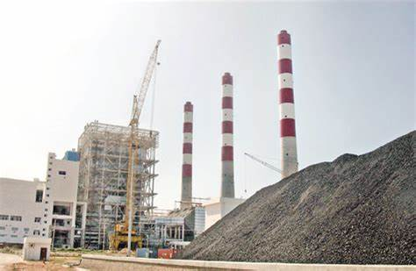
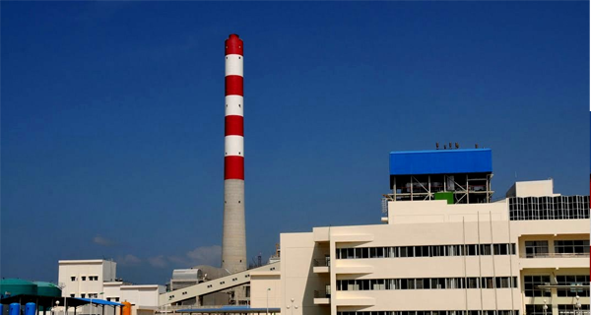
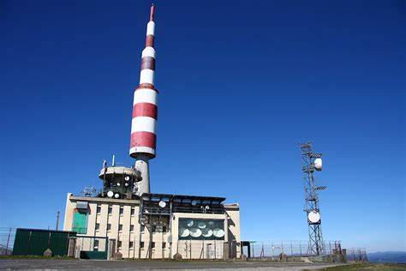

Slide 8
THE PROBLEM STATEMENT
LAKVIJAYA power plant is Sri Lankan’s first power plant. It generates electricity from burning coal and liquid fuel.
Coal-fired power plant expose people to toxic particles , ozone and heavy metals. The most serious health impact are due to microscopic particles.
Air pollution from coal power plants is linked with cansers, heart problems,acid rain, global warming and public health impacts.
High noise release by pressure steam and running fans and motors.

Slide 9
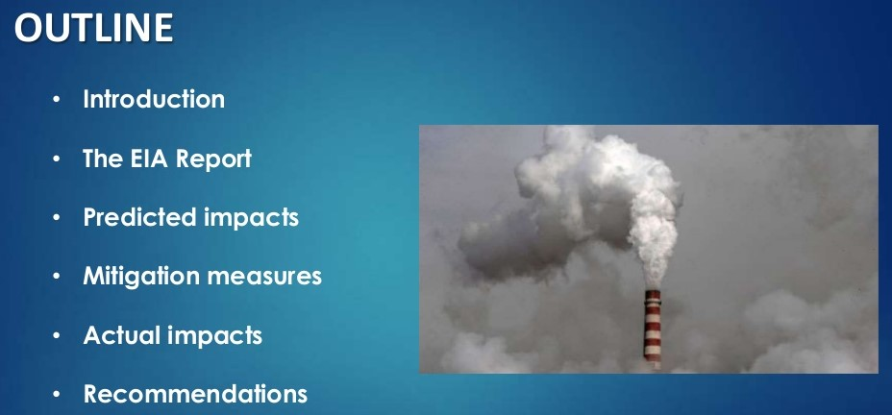
OBJECTIVE
Norochcholai coal plant will emit 2856 tonnes CO2 daily and generate 70,000 tones of fly ash
Dust from the coal stock pile covering large acreage will be devotes in open camps and shrine itself.
sulphur composition into fly ash setting on the crop and daily working of the farm.
Higher temperature(40 degree) chasing the marine life away while harming the breading
So we are going to find the solution to decrease this environmental impacts.
Notes:
© Copyright Showeet.com – Free PowerPoint Templates

Slide 10
DETAILED METHODOLOGY
The topic was chosen by us as “Pollution happen due to the activities of Norochcholai power plant.
Then we were gathered and discussed about the topic then we decided to visit Norochcholai power plant to do our project successfully.
Before some information were found from the internet and news paper articles.
Now after, we will take permission from Norochcholai power plant engineers to visit there.
After getting permission we will go there and we will gather information who are living near to power plant and what the problem they are facing due to this activities.
And we give some questionnaire to those peoples and labours who working there.
Finally we will arrange that information and make a presentation about that problem and give suitable solution for Norochcholai power plant thorough that presentation.

Slide 11
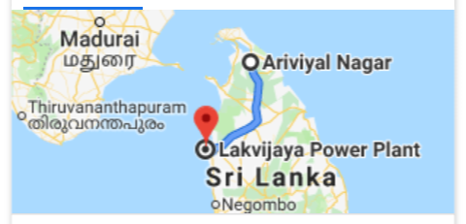

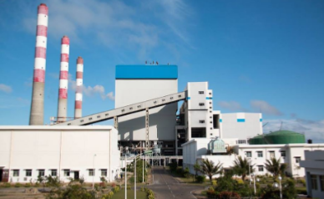
BUDGET AND TIMELINE
we have decided to go there from Ariviyal Nagar, Kilinochchi to Norochcholai power plant in Puttalam on 27th,28th July.
Travelling cost - (300*6)*2 = Rs 3600/=
Food cost - ( 6*100)*3 = Rs 1800/=
Paper cost = Rs 200/=
Total = Rs 5600/=
Distance – 220 km
This journey will take approximately 5 hours.
Ask questionnaires and field visit about 4 hours in power plant.
Visit to the around villages about 4 hours
Ariviyal nagar, __ Norochcholai,
Kilinochchi Puttalam

Slide 12
Questionnaires
1.Ask from workers.
How the power generate procedure happen?
How do you take water for making steam ?
What do you do for the burning ash (bottom ash)?
2. Ask from villagers.
What do you think about this power plant?
Can you find job opportunities from this?
Are there any health problem caused because of this ?
Are there any affects to your cultivation because of this?

Slide 13
TIME FRAMEWORK
 | WEEK
 | 1 | 2 | 3 | 4 | 5 | 6 | 7 | 8 | 9 | 10 | 11 | 12 | 13
Discuss with group members and select a topic
Getting the permission for the topic
Search details on the selected topic
Plan the project
Presenting the project proposal
To get the permission to visit Noraichcholai
Visit the Noraichcholai
Visit the surrounding area and talk with people
Collecting data from Internet
To discuss about final sample project
Analysis the all data
Implementing the solutions
Finalizing and presenting the project report

Slide 14

Thank you

